Slide 1
Course - DT228/1 and DT282/1
Subject - Computer Architecture and Technology
VON NEUMANN ARCHITECTURE - Part 2
Semester 2, Week 8

Slide 2
To Recap ‘Part One’
Last week’s notes introduced the architecture and the idea of the ‘Fetch-Execute Cycle’.
RAM holds program instructions and data.
The CPU fetches machine language instructions from Cache or RAM one after another and executes them without understanding what it does or how it does it.
Instructions must be perfect, complete and unambiguous because the CPU can do nothing but execute them exactly as they are written.

Slide 3
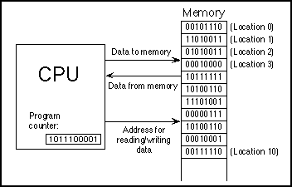
Simple View of CPU in Operation

Slide 4
More on the Fetch-Execute Cycle
Often the CPU actually has several tasks to perform.
All modern computers use ‘multitasking’ to perform several tasks at once, devoting a fraction of a second to each task in turn.
This application of multitasking is called ‘timesharing’. For example, the user might be typing a document while a clock is continuously displaying the time and a file is being downloaded from the internet.
Each individual tasks of a CPU is called a ‘thread’.

Slide 5
To Include the ‘Store’ Operation
Some books on Architecture prefer the ‘Fetch-Execute Cycle’ while others talk about a ‘Fetch-Execute-Store Cycle’.
Here are a few slides to show the ‘Store’ feature… plus one more showing ‘ADD’ because the ADD operation is most common in the CPU.

Slide 6
Memory Operations
Two basic operations occur within this subcomponent: a fetch operation, and a store.
The fetch operation:
A cell address is loaded into the MAR.
The address is decoded, which means that through circuitry, a specific cell is located.
The data contents contained within that cell are copied into another special register, called a Machine (or Memory) Data Register (MDR).
Note that this operation is non-destructive – that is, the data contents are copied, but not destroyed.

Slide 7
Memory Operations
The second memory operation is called a store.
The fetch is like a read operation; the store is like a write operation.
In the store, the address of the cell into which data is going to be stored is moved to the MAR and decoded.
Contents from yet another special register, called an accumulator, are copied into the cell location (held in the MAR).
This operation is destructive, meaning that whatever data was originally contained at that memory location is overwritten by the value copied from the accumulator.

Slide 8
Load Fetch-Execute Cycle
PC -> MAR | Transfer the address from the PC to the MAR
MDR -> IR | Transfer the instruction to the IR
IR(address) -> MAR | Address portion of the instruction loaded in MAR
MDR -> AC | Actual data copied into the accumulator
PC + 1 -> PC | Program Counter incremented

Slide 9
Store Fetch-Execute Cycle
PC -> MAR | Transfer the address from the PC to the MAR
MDR -> IR | Transfer the instruction to the IR
IR(address) -> MAR | Address portion of the instruction loaded in MAR
AC -> MDR | Accumulator copies data into MDR
PC + 1 -> PC | Program Counter incremented
Notice how Step 4 differs for LOAD and STORE

Slide 10
ADD Fetch-Execute Cycle
PC -> MAR | Transfer the address from the PC to the MAR
MDR -> IR | Transfer the instruction to the IR
IR(address) -> MAR | Address portion of the instruction loaded in MAR
AC + MDR -> AC | Contents of MDR added to the contents of the accumulator
PC + 1 -> PC | Program Counter incremented

Slide 11
Instruction and Data Movement
The Fetch-Execute Cycle means that the processor must interact with registers, cache memory, RAM – and then a long list of other hardware input-output and storage devices.
How do these strings of binary numbers move from device to device?
They take the bus! (Buses, actually…)

Slide 12
Personal Computer Buses
A bus is a common pathway across which data can travel within a computer. This pathway can be established between two or more computer elements.

Slide 13
Personal Computer Buses (2)
These pathways are on the computer's motherboard, interconnecting the microprocessor with attachments to the motherboard in expansion slots - such as the hard disk drive, CD-ROM drive, graphics card, sound card…

Slide 14
Personal Computer Buses (3)
There are a number of types of buses, including the following:
Processor bus
Address bus
Memory bus
System – or I/O bus (Input/Output bus)
Processor Bus + Memory Bus + Data Bus = System Bus

Slide 15
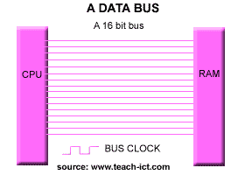
Bus Capacity: (32 and 64-Bit)
This 16 bit example is for visual only. More likely to be 32 or 64 or even 128-bit at processor level

Slide 16
Processor Bus
The processor bus is the communication pathway between the CPU and immediate support chips.
Support chips = ‘Chipsets’.
This bus is used to transfer data between the CPU and the main system bus, for example, or between the CPU and an external memory cache.

Slide 17
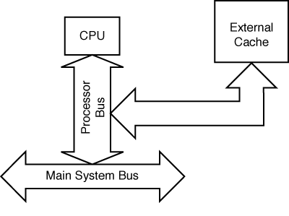
Processor Bus (2)
Figure 2 shows how this bus fits into a typical PC system.
FIG. 2 The processor bus

Slide 18
Processor Bus (3)
The processor bus is required:
to get information to/from the CPU at fastest possible speed -
so this bus operates at a much faster rate than any other bus on a PC.
The processor bus consists of electrical circuits for data, for addresses (the address bus), and for control purposes. The same ‘control’ as the CPU’s Control Unit.

Slide 19
Processor Bus (4)
In a Pentium-based system, the processor bus has 64 data lines, 32 address lines, and associated control lines.
The processor bus operates at the same base clock rate as the CPU does externally. The processor bus is tied to the external processor pin connections and can transfer one bit of data per data line every one or two clock cycles.
Thus, for example, a Pentium, Pentium Pro, or Pentium II could transfer 64 bits of data at a time.

Slide 20
Address Bus
The address bus is a computer bus architecture used to transfer data between devices that are identified by the hardware address of the physical memory (the physical address).
Since a Pentium system bus consists of 64 data lines, 32 address lines (36 in a Pentium Pro or Pentium II), and a few control lines, these address lines constitute the address bus.
In some block diagrams of textbooks, this bus is actually considered to represent the processor and memory buses together.

Slide 21
Address Bus (2)
The address bus is used to indicate what address in memory or what address on the system bus are to be used in a data transfer operation.
The address bus indicates precisely where the next bus transfer or memory transfer will occur.
The size of the memory bus also controls the amount of memory that the CPU can address directly.

Slide 22
Memory Bus
The memory bus is used to transfer information between the CPU and main memory - the RAM in a personal computer system.
A memory bus may be part of the processor bus itself, but in most cases is implemented separately by a dedicated chipset for transferring information between the processor bus and the memory bus.

Slide 23
Memory Bus (2)
** Note: **
In virtually all systems that are 16MHz or faster, there will be a special memory controller chipset that controls the interface between the faster processor bus and the slower main memory.
This chipset typically is the same chipset that is responsible for managing the I/O bus.

Slide 24
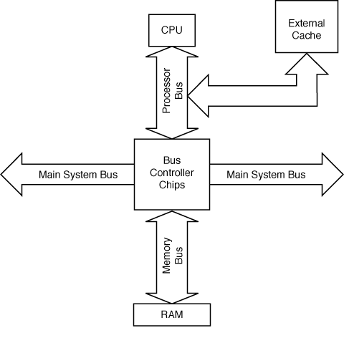
Memory Bus (3)
Figure 3 shows how the memory bus fits into your PC.
FIG. 3 The memory bus

Slide 25
Memory Bus (4)
Information on the memory bus is transferred at a much slower rate than the information on the processor bus.
The chip sockets (or the slots) for memory SIMMs/DIMMs are connected to the memory bus in much the same way that expansion slots are connected to the I/O bus.
(SIMMS/DIMMS = Single/Dual Inline Memory Modules)

Slide 26


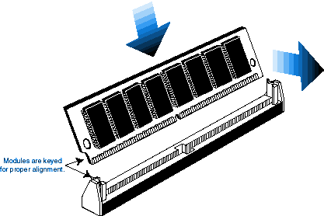
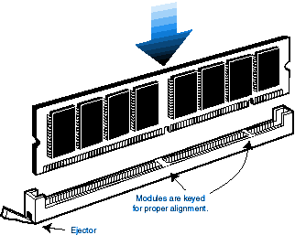
SIMMs and DIMMs
SIMMS/DIMMS = Single/Dual Inline Memory Modules
72p in SIMM – SIMM locating below
168p in DIMM – DIMM locating below

Slide 27
The System Bus
The system bus, also known as the I/O bus or the expansion slot bus is the one over which most data flows.
Any signal that goes to or from any device such as a video system, disk drives, and printer - travels over this bus.
The busiest I/O pathway is, typically, to and from a video card.

Slide 28
Types of System – or I/O Buses
Many I/O buses are introduced to give better system performance for:
Faster CPUs
Increasing software demands
Greater multimedia requirements.

Slide 29
System (I/O) Bus
Many modern PC systems still incorporate the same basic bus architecture as the old IBM PC/AT of @ 1984 - but also include a second high-speed local I/O bus such as
VL-Bus (VESA Local Bus, popular in mid 1990s) or
PCI (Peripheral Component Interconnect- a more modern architecture),
which offer much greater performance for adapters that need it.

Slide 30
System (I/O) Bus (2)
You can identify different types of I/O buses by their architecture. E.g.
ISA (Industry Standard Architecture),
PCI Local Bus (Peripheral Component Interconnect),
FireWire,
USB (Universal Serial Bus)….

Slide 31
System (I/O) Bus (3)
I/O
Memory
Video
CPU
System Bus
FIG. 1 ISA (Industry Standard Architecture)

Slide 32
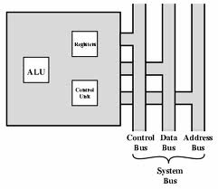
System (I/O) Bus (4)
Each bus architecture is implemented by a chipset that is connected to the processor bus. Typically, this chipset also controls the memory.

Slide 33
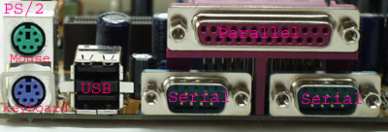

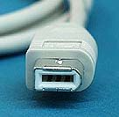

Connecting Things to a PC (Pictures)
Connectors for PC Buses
USB Connectors
SCSI Card
6-Pin FireWire Connector

Slide 34
Expansion Slots
Expansion slots allow devices to be added to a computer.
The connector has a series of connection pinholes; depending on the need of the device card, they may have 16 to 64 closely-spaced holes to connect to the motherboard.
The slot itself is a place to fit an expansion card containing the circuitry that provides a particular capability.

Slide 35
Expansion Slots (2)
The I/O bus or expansion slots:
They enable a CPU to communicate with, or add peripheral devices to, your computer to expand its capabilities.

Slide 36
Expansion Slots (3)
Devices such as:
sound cards,
video cards,
network interface cards,
(Small Computer System Interface) SCSI host adapters
(Universal Serial Bus) USB
and others can be plugged into expansion slots.

Slide 37
Motherboard Bus Example: The ISA Bus
ISA (Industry Standard Architecture) is the bus architecture that was introduced as an 8-bit bus with the original IBM PC in 1981 and later expanded to 16 bits with the IBM PC/AT in 1984.
ISA data transfers require from two to eight cycles of the processor clock. Therefore, the theoretical maximum data rate of the ISA bus is about 8 Mbyte/sec.

Slide 38
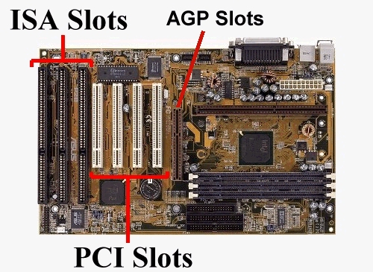
Motherboard Bus Example (2)
ISA is still being used for reasons of reliability, affordability, and compatibility. As it happens, this old bus is still faster than many of the peripherals that are connect to it.
ISA = Industry Standard Architecture
AGP = Advanced Graphics Port
PCI = Peripheral Component Interconnect

Slide 39
Programmed I/O
The programmed input/output (PIO) interface was the original method used to transfer data between the CPU, through the ATA controller, and an ATA device.
(ATA =Advanced Technology Attachment is a standard interface for connecting storage devices such as hard disks and CD-ROM drives inside personal computers.)

Slide 40
Programmed I/O (2)
The Programmed I/O interface is grouped into different modes for different transfer rates.
This was a slow means of data transfer – around 3.5 Megabytes per second.

Slide 41
Memory–Mapped I/O
I/O addresses are like bi-directional ‘post boxes’ in the computer’s memory device.
When the information from a device needs to be placed into the PC it needs to have a place for the data.
For this reason each device might have its own small area of memory to use. The name for this is ‘memory-mapped I/O’.

Slide 42
Memory–Mapped I/O (2)
When the device has a byte of data to send it sets device's designated I/O address space.
When the CPU is ready to process the data it gets it from this area.
When it later wants to send data to or through the device it uses this address again (or another one near it). This is a simple way of dealing with information exchange between devices.

Slide 43
Memory–Mapped I/O (3)
Memory-mapped I/O uses the same bus to address both memory and I/O devices.
The CPU instructions used to read and write to memory are also used in accessing I/O devices.

Slide 44
Memory–Mapped I/O (4)
So, instead of having "real" memory (RAM) as an address, for an I/O device the device has its own address space.
An address can be placed an I/O device.
Thus, communicating with an I/O device can be the same as reading and writing to memory addresses devoted to the I/O device.

Slide 45
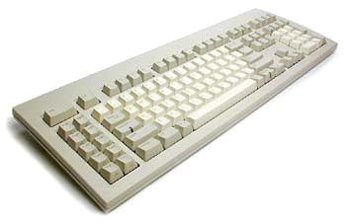
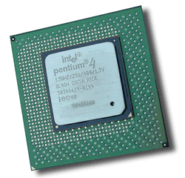
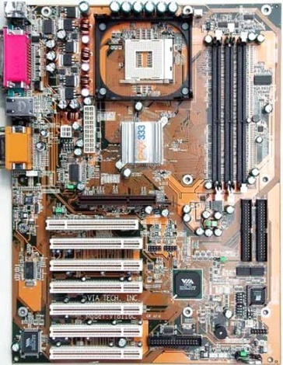
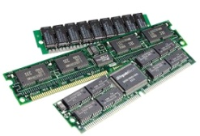
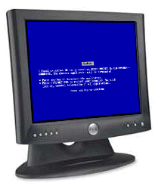
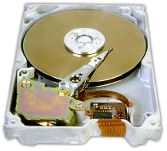
Hardware Organization
CPU
memory
Hard drive connects to Extended IDE
motherboard
hard drive
If you consider any electronic connection between components on the motherboard (including port points like the parallel, serial and USB connectors) that carries data, then you can assume it to be a bus. I.e. all copper circuits and parts of chipsets.

Slide 46
End of Part 2
That was the second of two lectures on the von Neumann Architecture.
Next week :
Interface Types

